Slide 1
DevOps Intro How to become a power user

Slide 2
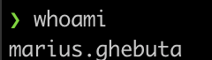
WhoAmI
8y experience in IT
4y experience as DevOps
2y in Nagarro
Mentored the first DevOps Internship in Nagarro
AWS Certified
Kubernetes Certified
RedHat Certified

Slide 3
Agenda
Intro
Why Nagarro?
Remote Learning and Internship
What is DevOps?
Roadmap
What are containers?
What are Clouds made of?
Cloud Security
What is CICD?
Learning Hacks
Portability
Productivity

Slide 4
- *DevOps Community - Provides support on your learning path/career path - Plenty of projects to choose from with latest and greatest tech - All kinds of events (TB, Wine tasting, Community events, Parties, Back to school, etc.) - Attending conferences - Flexibility (WFH, WFA) - “The StartUp experience without the drawbacks”
Why Nagarro?

Slide 5
Remote Learning & Internship
Remote Learning(15-20w):
Java
C#
WebDev
C++
Summer Internship(6-10w):
UI/UX
Business Analyst
Mobile Apps
Mobile Apps Testing
DevOps
Weekly meeting with mentors
Documentation and assignments
Continuous feedback
Emulating project work
Best practices
Latest & greatest tools
Nagarrian mentors
Goal: Students upskill and ocassionally career shifting

Slide 6
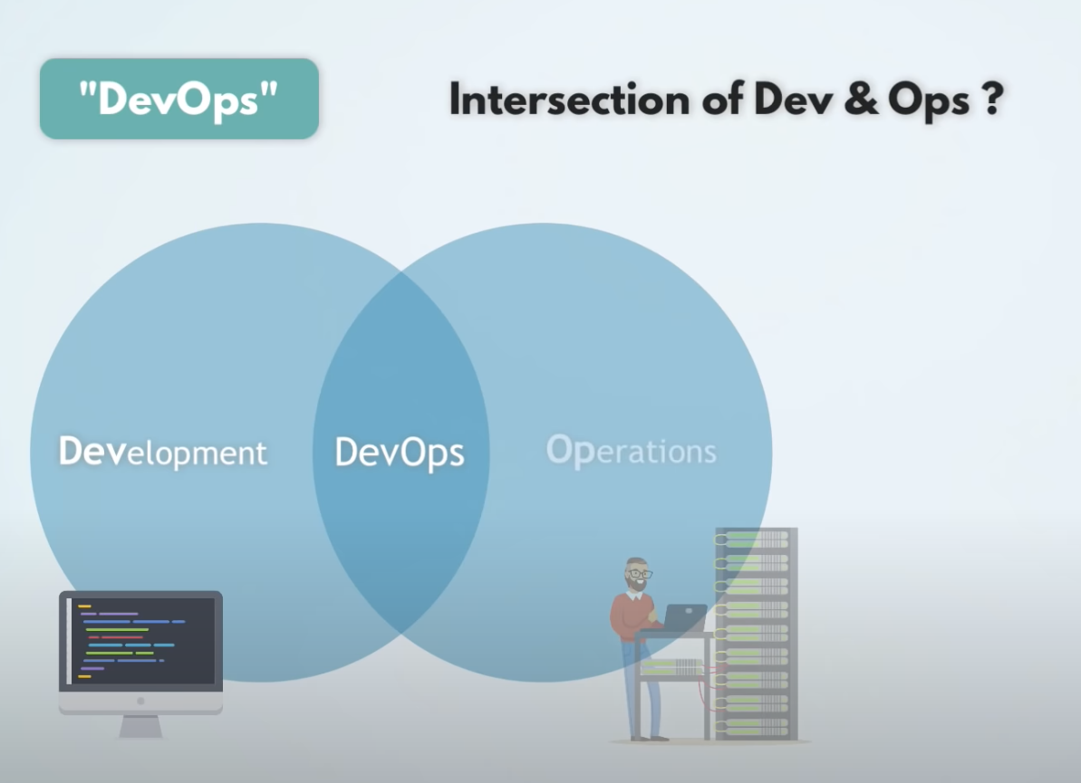
What is DevOps?
“Jack of all trades, master of none”
Recommendation:
Develop a skill (Ops or Dev) vertically
and then scale horizontally.

Slide 7
DevOps RoadMap
# | DevOps Tracks
1 | Networking
2 | Linux
3 | Programming
4 | Monitoring
5 | Logging
6 | Cloud
7 | Containerization
8 | CICD
9 | IaC/Configuration Management
10 | Git*
https://roadmap.sh/devops
https://landscape.cncf.io/

Slide 8
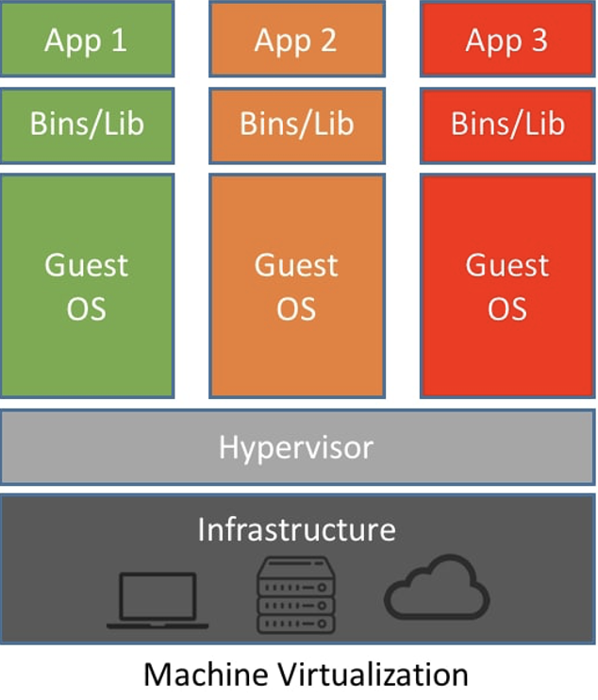
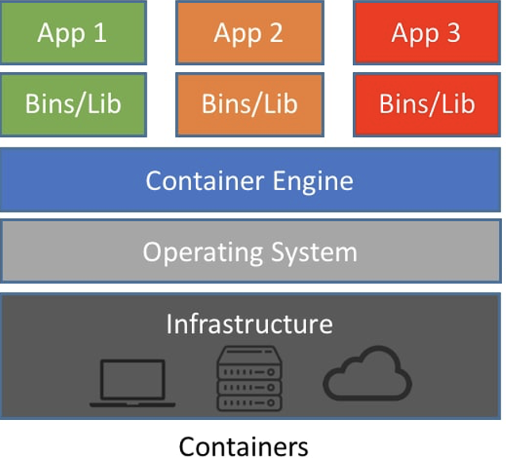
What are containers?

Slide 9
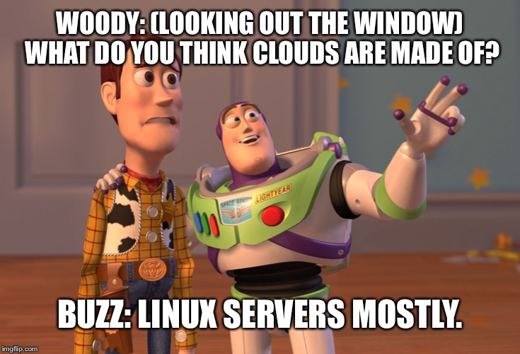
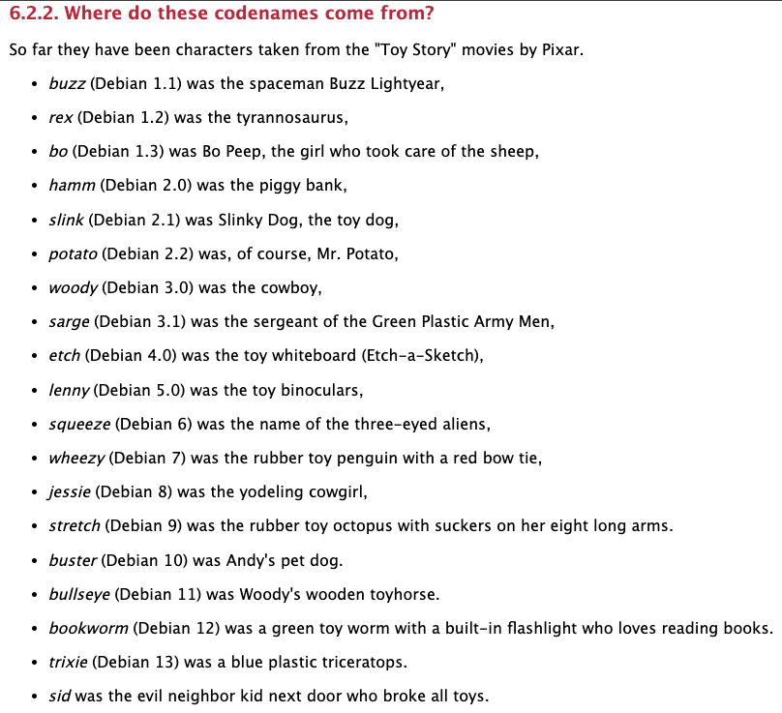
What are Clouds made of?
Fun fact:
- Debian distros are named after Toy Story characters.
Short answer: Managed services

Slide 10



Security
Security recommendations in the Cloud:
Strong password for root user.
Enable MFA.
Password expiration for users.
Prevent password re-use.
Use instance profiles/roles to manage permissions for users and AWS services.
Create another user with the right permissions for your daily endeavours.
The Principle of Least Privilege.
Rotate passwords and API Keys.
Shared responsibility model.
Check Trusted Advisor and Security Hub.
Keep up to date with security threats .
Watch out it can get expensive quickly!

Slide 11
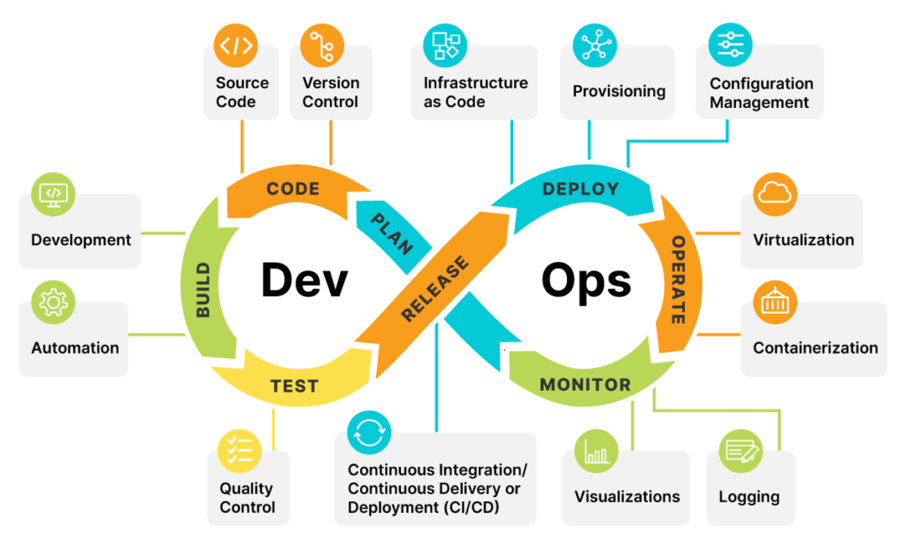
What is CICD?
CI - Continuous Improvement
Continuous Improvement → is the part which takes care of shipping quality code fast by leveraging tests, builds all bundled in the magic of automation.
CD - Continuous Deployment/Delivery
Continuous Deployment → is the process of moving software that has been built and tested successfully into production.
Continuous Delivery → is an approach which incorporates the concepts of continuous integration, automated testing and continuous deployment.
The difference between continuous delivery and deployment is that business teams may decide not to release software into production with continuous delivery due to various reasons.

Slide 12
Learning hacks
Give yourself time
Participate in challenges
https://adventofcode.com/
Capture the flag events
https://codeforces.com/problemset?order=BY_RATING_DESC
Make it fun by playing games
https://www.hackerrank.com/domains/shell (Linux)
https://www.openvim.com/ (VIM - Linux Text Editor)
https://cssbattle.dev/ or https://flexboxfroggy.com/ (CSS – Frontend)
https://learngitbranching.js.org/ (Git concepts)
Your system is powerful enough. Use free online sandboxes
https://www.docker.com/play-with-docker/ (Docker)
https://training.play-with-kubernetes.com/kubernetes-workshop/ (Kubernetes)
Make it fun
Be consistent

Slide 13
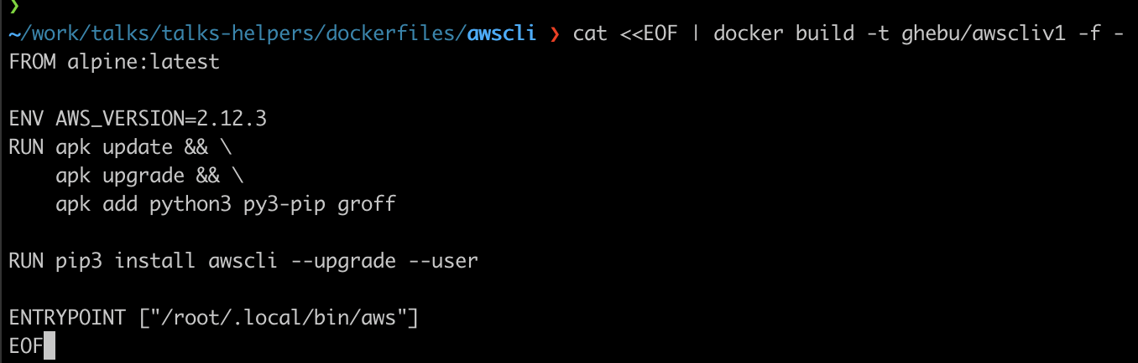
Portability
Docker run or brew install?!
CICD for pet projects
Github actions
Ephemeral Jenkins
https://github.com/marcel-dempers/my-desktop/tree/master/dockerfiles
https://youtu.be/acIntRLxxm0

Slide 14
Productivity
Tools:
Tmux - <insert Matrix meme here>
Rectangle (MacOS)
ZSH Plugins
git
zsh-autosuggestions
zsh-syntax-highlighting
WSL (Windows Sub System for Linux)
RSS Feed (i.e Feedly) – Control the information you consume
KeyClu
Sourcetree (Git Helper/GUI)
Github Projects/Trello/gqueues,etc
Shortcuts:
Touchpad gestures
Using virtual desktops
Clipboard history
Shell shortcuts
Browser shortcuts
Personal favorites:
- Touch Typing Games

Slide 15
Productivity – Fake it ’till you make it
docker run --rm -it bcbcarl/hollywood

Slide 16

Q&A
Thank you for you attendance!
“Act like your 35!”
GitHub Links:
https://github.com/ghebu/noaptea-companiilor23
https://github.com/ghebu/MariusLaboratory

Slide 17
Appendix

Slide 18
Terraform Recommendations
Terraform Remote State
Versioning
Harden the S3 Bucket with IAM/ACL policies.
Backend config during terraform init
Keep it as DRY as possible
Abuse the TF conditionals
For_each
Count
Dynamic blocks
Ternary operators
Develop it with reusability in mind

Slide 19
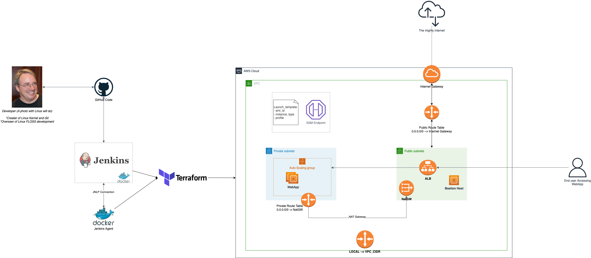
“Thou Art Demo God”

